Slide 1

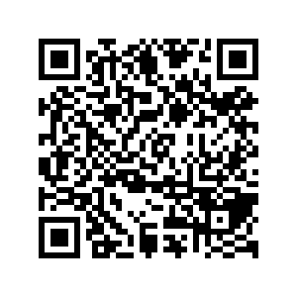
CS1010: Programming Methodology
UNIT 2
Computational Problems and Algorithms
Live Q&A
https://pollev.com/jin

Slide 2
Unit 2: Computational Problems and Algorithms
Computational Problems
Algorithm
Flowchart
Variables
Correctness

Slide 3
Computational Problems
Problems that
have well-defined inputs, outputs, and constraints
can be solved step-by-step by a computer

Slide 4
Computational Problems
Example (Decision Problem)
Is 1933091 prime?
What are the inputs, outputs and constraints?
Is there a step-by-step method to solve it using a computer?

Slide 5
Computational Problems
Example (Decision Problem)
Is there a route from Point A to Point B?
What are the inputs, outputs and constraints?
Is there a step-by-step method to solve it using a computer?

Slide 6
Computational Problems
Example (Search Problem)
Find a route from Point A to Point B.
Example (Counting Problem)
How many different routes are there from Point A to Point B?
Example (Optimization problem)
Find the shortest route from Point A to Point B.

Slide 7
Non-Computational Problems
Examples
What is the meaning of life?
Do I look good in this outfit?

Slide 8
Problem Solving Process
Algorithmic
Determine problem features
Analysis
Iterative process
Write algorithm
Design
Produce code
Implementation
What is an algorithm?
Check for correctness and efficiency
Testing

Slide 9
Algorithm
An algorithm is a well-defined computational procedure consisting of a set of instructions, that takes some value or set of values as input, and produces some value or set of values as output.
Input
Algorithm
Output
‘Algorithm’ stems from ‘Algoritmi’, the Latin form of al-Khwārizmī, a Persian mathematician, astronomer and geographer.
Source: http://en.wikipedia.org/wiki/Algorithm

Slide 10
Algorithm: Example
Problem: Find the maximum among a list of numbers.
Sample input: 6, {5, 9, 8, 1, 3, 2}
Sample output: 9
What are the inputs, outputs and constraints?
Inputs: a number k = the size of the list, a list of k numbers l = ⟨l₀,...,l_{k−1}⟩
Outputs: a number m
Constraints: m ∈ L and m ≥ l_{i} for all i.
l₀, l₁ , l₂, l₃, l₄, l₅

Slide 11
Algorithm: Example
Problem: Find the maximum among a list of numbers.
Sample input: 6, {5, 9, 8, 1, 3, 2}
Sample output: 9
What is the (rough) algorithm?
Scan through the list and keep track of the maximum
l₀, l₁ , l₂, l₃, l₄, l₅

Slide 12
Algorithm: Example
Problem: Find the maximum among a list of numbers.
Sample input: 6, {5, 9, 8, 1, 3, 2}
Sample output: 9
What is the (detailed) algorithm?
Record the maximum (m) so far with m = l₀ initially
Record the index (i) of the number being considered with i = 1 initially
l₀, l₁ , l₂, l₃, l₄, l₅

Slide 13
Algorithm: Example
Problem: Find the maximum among a list of numbers.
Sample input: 6, {5, 9, 8, 1, 3, 2}
Sample output: 9
What is the (detailed) algorithm?
Keep going as long as there are more numbers (i.e., i does not equal k)
if m < l_{i}, then update m with the value of l_{i}
Increase i by 1
l₀, l₁ , l₂, l₃, l₄, l₅

Slide 14
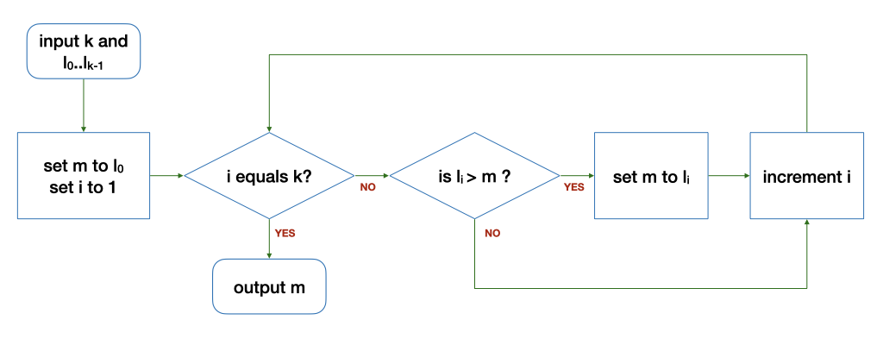
Algorithm: Example
The Flowchart
The loop
Input: 6 5 9 8 1 3 2
k | i | l_{i} | m | Remark
6 | 1 | 9 | 5 | Before the loop
6 | 2 | 8 | 9 | After 1st round of the loop
6 | 3 | 1 | 9 | After 2nd round…
k | i | l_{i} | m | Remark
6 | 4 | 3 | 9 | After 3rd round…
6 | 5 | 2 | 9 | After 4th round…
6 | 6 | - | 9 | After 5th round…

Slide 15
Variables
i, m, k, l and l_{k} are variables (a.k.a., data)
They hold a value in their respective location in the memory
You can
read a value from a variable (e.g., output m)
write a value to a variable (e.g., set i to 1)
compare values of two variables (e.g., i equals k?)
Perform arithmetic operations on variables (e.g., compute i + 1)

Slide 16
Control structures
Sequence
After step X, do step Y.
Selection
If … then … else …
Repetition
Keep going as long as ...

Slide 17
Correctness
An algorithm is correct (i.e., bug free) if it works on all valid inputs.
Very often, a buggy algorithm works on some inputs but fails on others…
To check correctness, you can
Find a counter-example to disprove the algorithm
Carefully choose a set of test cases to verify the correctness
Argue formally about the property of the algorithms

Slide 18
Correctness
What is wrong with this modified algorithm?
0

Slide 19
Homework
Post-Lecture Quiz
To be released every Tuesday, 2pm and due the next Tuesday, 2pm
Unlimited number of attempts.
Problem Set 2.1 to 2.3 (under Unit 2)
To be discussed in the forum
Course website and programming environment
Submission of Github account name via Canvas

